Slide 1
Autoencoders

Slide 2
What are Autoencoders?

Slide 3
What are Autoencoders?
An autoencoder neural network is an Unsupervised Machine learning algorithm that applies backpropagation, setting the target values to be equal to the inputs. Autoencoders are used to reduce the size of our inputs into a smaller representation. If anyone needs the original data, they can reconstruct it from the compressed data.

Slide 4
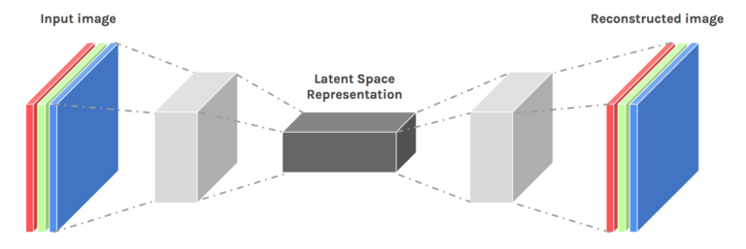
What are Autoencoders?
An autoencoder neural network is an Unsupervised Machine learning algorithm that applies backpropagation, setting the target values to be equal to the inputs. Autoencoders are used to reduce the size of our inputs into a smaller representation. If anyone needs the original data, they can reconstruct it from the compressed data.

Slide 5
PCA vs Autoencoders

Slide 6
PCA vs Autoencoders
An autoencoder can learn non-linear transformations with a non-linear activation function and multiple layers.

Slide 7
PCA vs Autoencoders
An autoencoder can learn non-linear transformations with a non-linear activation function and multiple layers.
It doesn’t have to learn dense layers. It can use convolutional layers to learn which is better for video, image and series data.

Slide 8
PCA vs Autoencoders
An autoencoder can learn non-linear transformations with a non-linear activation function and multiple layers.
It doesn’t have to learn dense layers. It can use convolutional layers to learn which is better for video, image and series data.
It is more efficient to learn several layers with an autoencoder rather than learn one huge transformation with PCA.

Slide 9
PCA vs Autoencoders
An autoencoder can learn non-linear transformations with a non-linear activation function and multiple layers.
It doesn’t have to learn dense layers. It can use convolutional layers to learn which is better for video, image and series data.
It is more efficient to learn several layers with an autoencoder rather than learn one huge transformation with PCA.
An autoencoder provides a representation of each layer as the output.

Slide 10
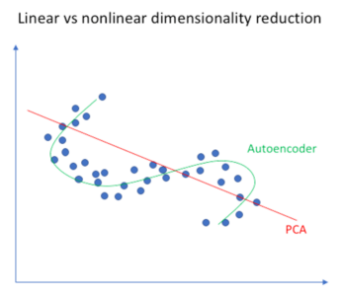
PCA vs Autoencoders
An autoencoder can learn non-linear transformations with a non-linear activation function and multiple layers.
It doesn’t have to learn dense layers. It can use convolutional layers to learn which is better for video, image and series data.
It is more efficient to learn several layers with an autoencoder rather than learn one huge transformation with PCA.
An autoencoder provides a representation of each layer as the output.
It can make use of pre-trained layers from another model to apply transfer learning to enhance the encoder/decoder.

Slide 11
Applications of autoencoders

Slide 12
Applications of autoencoders
1. Image colouring

Slide 13
Applications of autoencoders
1. Image colouring
Autoencoders are used for converting any black and white picture into a colored image. Depending on what is in the picture, it is possible to tell what the color should be.

Slide 14
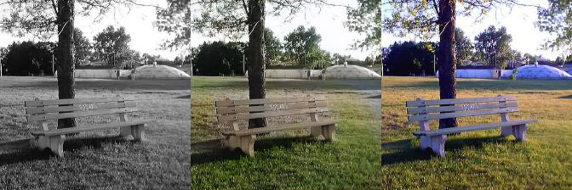
Applications of autoencoders
1. Image colouring
Autoencoders are used for converting any black and white picture into a colored image. Depending on what is in the picture, it is possible to tell what the color should be.

Slide 15
2. Feature variation

Slide 16
2. Feature variation
It extracts only the required features of an image and generates the output by removing any noise or unnecessary interruption

Slide 17
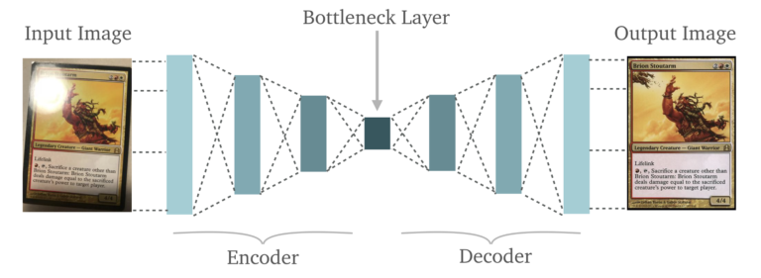
2. Feature variation
It extracts only the required features of an image and generates the output by removing any noise or unnecessary interruption

Slide 18
3. Dimensionality Reduction

Slide 19
3. Dimensionality Reduction
The reconstructed image is the same as our input but with reduced dimensions. It helps in providing the similar image with a reduced pixel value.

Slide 20
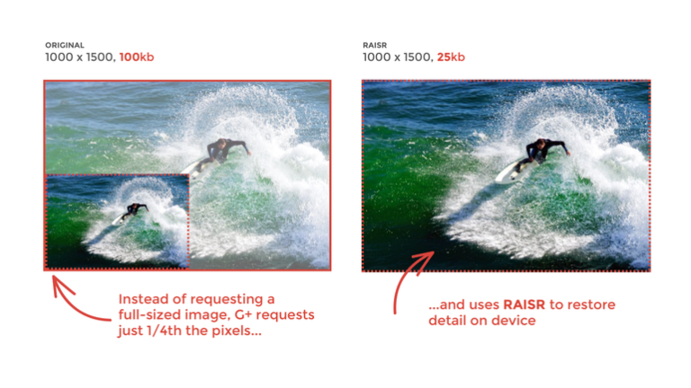
3. Dimensionality Reduction
The reconstructed image is the same as our input but with reduced dimensions. It helps in providing the similar image with a reduced pixel value.

Slide 21
3. Dimensionality Reduction
The reconstructed image is the same as our input but with reduced dimensions. It helps in providing the similar image with a reduced pixel value.
RAISR: Rapid and Accurate Image Super-Resolution

Slide 22
4. Denoising Image

Slide 23
4. Denoising Image
The input seen by the autoencoder is not the raw input but a stochastically corrupted version. A denoising autoencoder is thus trained to reconstruct the original input from the noisy version.

Slide 24
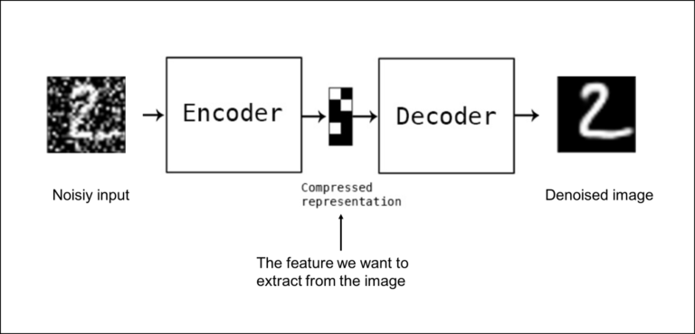
4. Denoising Image
The input seen by the autoencoder is not the raw input but a stochastically corrupted version. A denoising autoencoder is thus trained to reconstruct the original input from the noisy version.

Slide 25
5. Watermark Removal

Slide 26
5. Watermark Removal
It is also used for removing watermarks from images or to remove any object while filming a video or a movie.

Slide 27

5. Watermark Removal
It is also used for removing watermarks from images or to remove any object while filming a video or a movie.

Slide 28
Architecture of Autoencoders

Slide 29
Architecture of Autoencoders
An Autoencoder consist of three layers:

Slide 30
Architecture of Autoencoders
An Autoencoder consist of three layers:
Encoder

Slide 31
Architecture of Autoencoders
An Autoencoder consist of three layers:
Encoder
Code

Slide 32
Architecture of Autoencoders
An Autoencoder consist of three layers:
Encoder
Code
Decoder

Slide 33
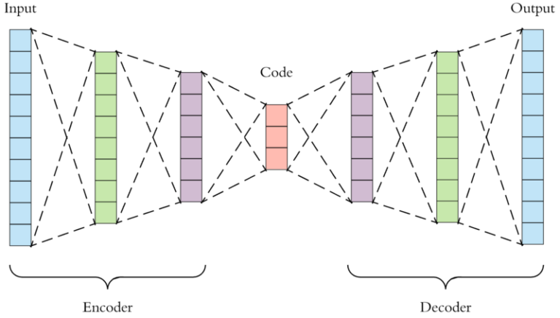
Architecture of Autoencoders
An Autoencoder consist of three layers:
Encoder
Code
Decoder

Slide 34
Encoder: This part of the network compresses the input into a latent space representation. The encoder layer encodes the input image as a compressed representation in a reduced dimension. The compressed image is the distorted version of the original image.

Slide 35
Encoder: This part of the network compresses the input into a latent space representation. The encoder layer encodes the input image as a compressed representation in a reduced dimension. The compressed image is the distorted version of the original image.
Code: This part of the network represents the compressed input which is fed to the decoder.

Slide 36
Encoder: This part of the network compresses the input into a latent space representation. The encoder layer encodes the input image as a compressed representation in a reduced dimension. The compressed image is the distorted version of the original image.
Code: This part of the network represents the compressed input which is fed to the decoder.
Decoder: This layer decodes the encoded image back to the original dimension. The decoded image is a lossy reconstruction of the original image and it is reconstructed from the latent space representation

Slide 37
The layer between the encoder and decoder, i.e.. the code is also known as Bottleneck. This is a well-designed approach to decide which aspects of observed data are relevant information and what aspects can be discarded. It does this by balancing two criteria :

Slide 38
The layer between the encoder and decoder, i.e.. the code is also known as Bottleneck. This is a well-designed approach to decide which aspects of observed data are relevant information and what aspects can be discarded. It does this by balancing two criteria :
Compactness of representation, measured as the compressibility.

Slide 39
The layer between the encoder and decoder, i.e.. the code is also known as Bottleneck. This is a well-designed approach to decide which aspects of observed data are relevant information and what aspects can be discarded. It does this by balancing two criteria :
Compactness of representation, measured as the compressibility.
It retains some behaviorally relevant variables from the input

Slide 40
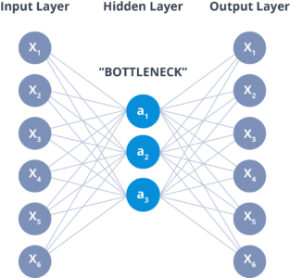
The layer between the encoder and decoder, i.e.. the code is also known as Bottleneck. This is a well-designed approach to decide which aspects of observed data are relevant information and what aspects can be discarded. It does this by balancing two criteria :
Compactness of representation, measured as the compressibility.
It retains some behaviorally relevant variables from the input

Slide 41
Hyperparameters of Autoencoders

Slide 42
Hyperparameters of Autoencoders
There are 4 hyperparameters that we need to set before training an autoencoder:

Slide 43
Hyperparameters of Autoencoders
There are 4 hyperparameters that we need to set before training an autoencoder:
Code size: It represents the number of nodes in the middle layer. Smaller size results in more compression.

Slide 44
Hyperparameters of Autoencoders
There are 4 hyperparameters that we need to set before training an autoencoder:
Code size: It represents the number of nodes in the middle layer. Smaller size results in more compression.
Number of layers: The autoencoder can consist of as many layers as we want.

Slide 45
Hyperparameters of Autoencoders
There are 4 hyperparameters that we need to set before training an autoencoder:
Code size: It represents the number of nodes in the middle layer. Smaller size results in more compression.
Number of layers: The autoencoder can consist of as many layers as we want.
Number of nodes per layer: The number of nodes per layer decreases with each subsequent layer of the encoder, and increases back in the decoder. The decoder is symmetric to the encoder in terms of the layer structure.

Slide 46
Hyperparameters of Autoencoders
There are 4 hyperparameters that we need to set before training an autoencoder:
Code size: It represents the number of nodes in the middle layer. Smaller size results in more compression.
Number of layers: The autoencoder can consist of as many layers as we want.
Number of nodes per layer: The number of nodes per layer decreases with each subsequent layer of the encoder, and increases back in the decoder. The decoder is symmetric to the encoder in terms of the layer structure.
Loss function: We either use mean squared error or binary cross-entropy. If the input values are in the range [0, 1] then we typically use cross-entropy, otherwise, we use the mean squared error.

Slide 47
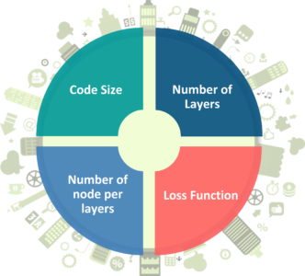
Hyperparameters of Autoencoders
There are 4 hyperparameters that we need to set before training an autoencoder:
Code size: It represents the number of nodes in the middle layer. Smaller size results in more compression.
Number of layers: The autoencoder can consist of as many layers as we want.
Number of nodes per layer: The number of nodes per layer decreases with each subsequent layer of the encoder, and increases back in the decoder. The decoder is symmetric to the encoder in terms of the layer structure.
Loss function: We either use mean squared error or binary cross-entropy. If the input values are in the range [0, 1] then we typically use cross-entropy, otherwise, we use the mean squared error.

Slide 48
Types of Autoencoders

Slide 49
Types of Autoencoders
1. Convolution Autoencoders

Slide 50
Types of Autoencoders
1. Convolution Autoencoders
Autoencoders in their traditional formulation does not take into account the fact that a signal can be seen as a sum of other signals. Convolutional Autoencoders use the convolution operator to exploit this observation. They learn to encode the input in a set of simple signals and then try to reconstruct the input from them, modify the geometry or the reflectance of the image.

Slide 51
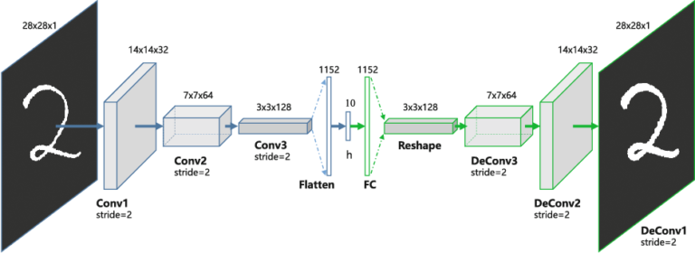
Types of Autoencoders
1. Convolution Autoencoders
Autoencoders in their traditional formulation does not take into account the fact that a signal can be seen as a sum of other signals. Convolutional Autoencoders use the convolution operator to exploit this observation. They learn to encode the input in a set of simple signals and then try to reconstruct the input from them, modify the geometry or the reflectance of the image.

Slide 52
Use cases of CAE:

Slide 53
Use cases of CAE:
Image Reconstruction

Slide 54
Use cases of CAE:
Image Reconstruction
Image Colorization

Slide 55
Use cases of CAE:
Image Reconstruction
Image Colorization
latent space clustering

Slide 56
Use cases of CAE:
Image Reconstruction
Image Colorization
latent space clustering
generating higher resolution images

Slide 57
2. Sparse autoencoders

Slide 58
2. Sparse autoencoders
Sparse autoencoders offer us an alternative method for introducing an information bottleneck without requiring a reduction in the number of nodes at our hidden layers. Instead, we’ll construct our loss function such that we penalize activations within a layer.

Slide 59
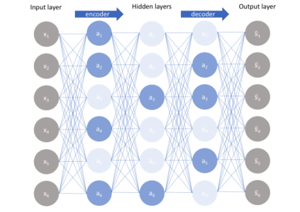
2. Sparse autoencoders
Sparse autoencoders offer us an alternative method for introducing an information bottleneck without requiring a reduction in the number of nodes at our hidden layers. Instead, we’ll construct our loss function such that we penalize activations within a layer.

Slide 60
3. Deep Autoencoders

Slide 61
3. Deep Autoencoders
The extension of the simple Autoencoder is the Deep Autoencoder. The first layer of the Deep Autoencoder is used for first-order features in the raw input. The second layer is used for second-order features corresponding to patterns in the appearance of first-order features. Deeper layers of the Deep Autoencoder tend to learn even higher-order features.

Slide 62
3. Deep Autoencoders
The extension of the simple Autoencoder is the Deep Autoencoder. The first layer of the Deep Autoencoder is used for first-order features in the raw input. The second layer is used for second-order features corresponding to patterns in the appearance of first-order features. Deeper layers of the Deep Autoencoder tend to learn even higher-order features.
A deep autoencoder is composed of two, symmetrical deep-belief networks-

Slide 63
3. Deep Autoencoders
The extension of the simple Autoencoder is the Deep Autoencoder. The first layer of the Deep Autoencoder is used for first-order features in the raw input. The second layer is used for second-order features corresponding to patterns in the appearance of first-order features. Deeper layers of the Deep Autoencoder tend to learn even higher-order features.
A deep autoencoder is composed of two, symmetrical deep-belief networks-
First four or five shallow layers representing the encoding half of the net.

Slide 64
3. Deep Autoencoders
The extension of the simple Autoencoder is the Deep Autoencoder. The first layer of the Deep Autoencoder is used for first-order features in the raw input. The second layer is used for second-order features corresponding to patterns in the appearance of first-order features. Deeper layers of the Deep Autoencoder tend to learn even higher-order features.
A deep autoencoder is composed of two, symmetrical deep-belief networks-
First four or five shallow layers representing the encoding half of the net.
The second set of four or five layers that make up the decoding half.

Slide 65
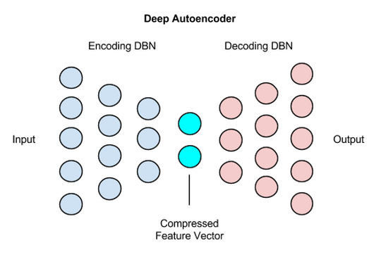
3. Deep Autoencoders
The extension of the simple Autoencoder is the Deep Autoencoder. The first layer of the Deep Autoencoder is used for first-order features in the raw input. The second layer is used for second-order features corresponding to patterns in the appearance of first-order features. Deeper layers of the Deep Autoencoder tend to learn even higher-order features.
A deep autoencoder is composed of two, symmetrical deep-belief networks-
First four or five shallow layers representing the encoding half of the net.
The second set of four or five layers that make up the decoding half.

Slide 66
Use cases of Deep Autoencoders

Slide 67
Use cases of Deep Autoencoders
Image Search

Slide 68
Use cases of Deep Autoencoders
Image Search
Data Compression

Slide 69
Use cases of Deep Autoencoders
Image Search
Data Compression
Topic Modeling & Information Retrieval (IR)

Slide 70
4. Contractive Autoencoders

Slide 71
4. Contractive Autoencoders
A contractive autoencoder is an unsupervised deep learning technique that helps a neural network encode unlabeled training data. This is accomplished by constructing a loss term which penalizes large derivatives of our hidden layer activations with respect to the input training examples, essentially penalizing instances where a small change in the input leads to a large change in the encoding space.

Slide 72
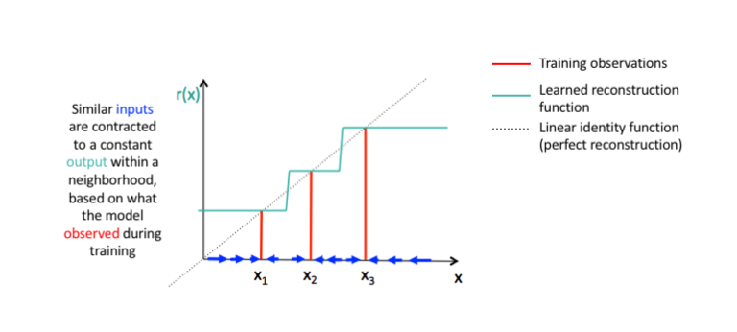
4. Contractive Autoencoders
A contractive autoencoder is an unsupervised deep learning technique that helps a neural network encode unlabeled training data. This is accomplished by constructing a loss term which penalizes large derivatives of our hidden layer activations with respect to the input training examples, essentially penalizing instances where a small change in the input leads to a large change in the encoding space.

